Slide 1
Online boosting algorithm based on two-phase SVM training and its application to image processing
Yugov Vsevolod
Kumazawa Lab
Tokyo Institute of technology

Slide 2
Contents
Introduction
Support Vector Machines
Primal and dual formulations
Offline training methods
SGD-based training methods
NORMA
Pegasos
Introducing Mercer kernels
Drawbacks of Kernels
Boosting
AdaBoost
Online boosting (Grabner et.al)
Our algorithm
Inspiration
Two-step linear Pegasos
Illustration of convergence
Comparison to kernel-based SVM
Comparison to AdaBoost
Comparison to online boosting
Convergence on different datasets

Slide 3
Contents
Summary of the first part
GPGPU computation
iPhone programmable graphics pipeline
GPUImage programming library
Pegasos modified for parallel processing
Implementing our algorithm on the mobile device for real-time image processing
Tracking as a classification problem
Boosting the simple features
Choosing the right features for parallel processing
Minimalized features
Combining online and batch learning
Resulting graphics pipeline

Slide 4
Contents
Implementation results
Relation of proposed implementation to existing work
Introducing FERNs for image processing
Adapting Ferns for use with our method
Texture recognition with Ferns
Implementation of simple texture recognition on iPhone GPU
Results
Spectrum of related classification methods
Conclusion
References

Slide 5
Introduction
Support vector machines are a powerful classification tool
Recently, there is a renewed interest in the simplified learning methods for SVM based on the gradient descent
This interest is due to the vast amount of large datasets and increasing availability of parallel processing
However, most proposed methods, especially for non-linear classifications have severe limitations

Slide 6
Support Vector Machines Maximum margin classifiers [Vapnik, 95]
Linearly separable dataset
Nonlinear SVM using Mercer Kernel

Slide 7
Support Vector Machines Risk minimization and VC (Vapnik-Chervolenski) dimension

Slide 8
Support Vector Machines Primal and dual problem formulations
Primal formulation
Dual formulation
Loss function

Slide 9
Support Vector Machines Offline training methods
Interior point methods for Quadratic Programming
Segmentation – based methods
Sequential Minimal Optimization
Gradient-based methods

Slide 10
Support Vector Machines Stochastic Gradient Descent based methods (online)

Slide 11
Support Vector Machines Stochastic Gradient Descent based methods
Gradient
Stochastic gradient

Slide 12
Support Vector Machines Norma [Kivinen 2004]
Pros
Cons
Very easy to calculate
Asymptotic convergence to the optimum
Supports various loss function for different applications
Can easily incorporate kernels
The convergence rate is quadratic, which is bad for larger datasets.

Slide 13
Support Vector Machines Pegasos
Pros:
Convergence much faster than NORMA
Cons:
The need to calculate norm of the weights vector on each iteration
Change of the loss function leads to unpredictable convergence
Projection step

Slide 14
Support Vector Machines Introducing Mercer kernels
To introduce nonlinearity, kernel trick is used
Kernels must conform to Mercer’s condition (i.e. positive definite kernels), otherwise convergence is not guaranteed
Many different kernels (including non-analytic kernel matrices) are possible for a wide variety of problems
The trick can be relatively easily incorporated into learning algorithms

Slide 15
Support Vector Machines Drawbacks of Kernel SVM
Increased VC dimension lead to looser bound on the generalization error.
In order to calculate classification function, multiple evaluations of (nonlinear) kernel function are necessary
Also, a large amount of the weights and input vectors have to be stored for calculation
Reducing the amount of stored vectors results in the quickly reducing accuracy

Slide 16
Our Algorithm Introducing boosting
Boosting combines several weak classifiers (with low accuracy) into a stronger one.
Usually uses linear combination of weak classifier’s output
Several good boosting algorithms exist (adaBoost, LPBoost)
Recently, several algorithms for online boosting were also developed
Boosting problem is closely related to SVM, although the loss functions are different

Slide 17
Boosting
Boosting combines several weak classifiers (with low accuracy) into a stronger one.
Usually uses linear combination of weak classifier’s output
Several good boosting algorithms exist (adaBoost, LPBoost)
Recently, several algorithms for online boosting were also developed
Boosting problem is closely related to SVM, although the loss functions are different

Slide 18
AdaBoost
A greedy algorithm formulated by Yoav Freund and Robert Schapire
Very effective and well-analyzed

Slide 19
Online boosting (Grabner et.al.)
Fixed number of classifiers
The error is approximated and refined over the iterations

Slide 20
Inspiration AdaBoost
The goal is to use boosting-like algorithm in the online setting without limiting its flexibility
Idea: stretch the AdaBoost update over several iterations
Idea: AdaBoost is mathematically similar to linear SVM in the classifier space.

Slide 21
Our Algorithm Idea: Two-step linear Pegasos
Use several linear classifiers as features for boosting
Instead of AdaBoost, use an online training algorithm
Both Norma and Pegasos can be used for linear training
Due to the similarity of boosting and SVM, the same methods can be applied to training
Conclusion: create a rapid two-step training algorithm utilizing Pegasos as a training base

Slide 22
Our Algorithm Diagram: Classification

Slide 23
Our Algorithm Diagram: Training

Slide 24
Our Algorithm Two-step linear Pegasos
Pegasos: weighted update function

Slide 25
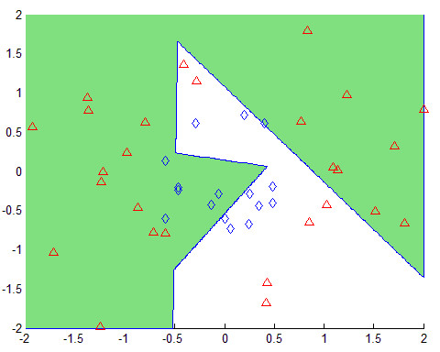
Our Algorithm Convergence process

Slide 26
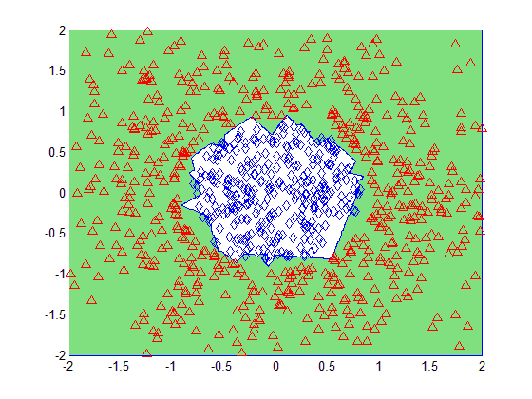
Our Algorithm Convergence process

Slide 27
Our Algorithm Comparison to Kernel SVM
SVMs with kernels
Our algorithm
The amount of expansion term is very large, comparable to the number of training samples
The kernel function and its parameters usually have to be precise for good convergence, depending on the data type
The amount of expansion terms (additional classifiers) is less than the amount of training samples by a controlled factor
The parameters have minimal influence on the convergence, unless the data is linearly separable

Slide 28
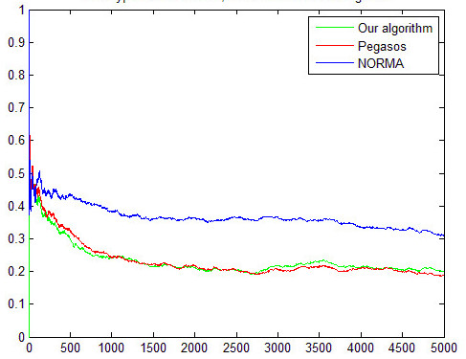
Our Algorithm Comparison to other methods
Our algorithm convergence rate was compared to that of Pegasos and Norma on several datasets, including both artificial and real data distributions
Forest Covertype Dataset (originally[Blackard 1999])
Linear SVM

Slide 29
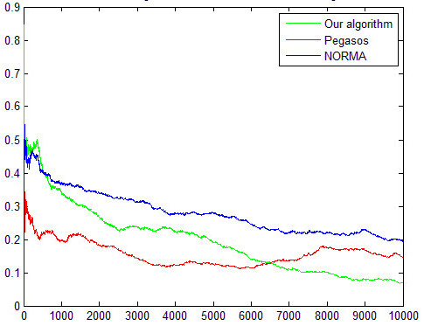
Our Algorithm Comparison to other methods
Bayes-separable dataset, NORMA and Pegasos using RBF kernels

Slide 30
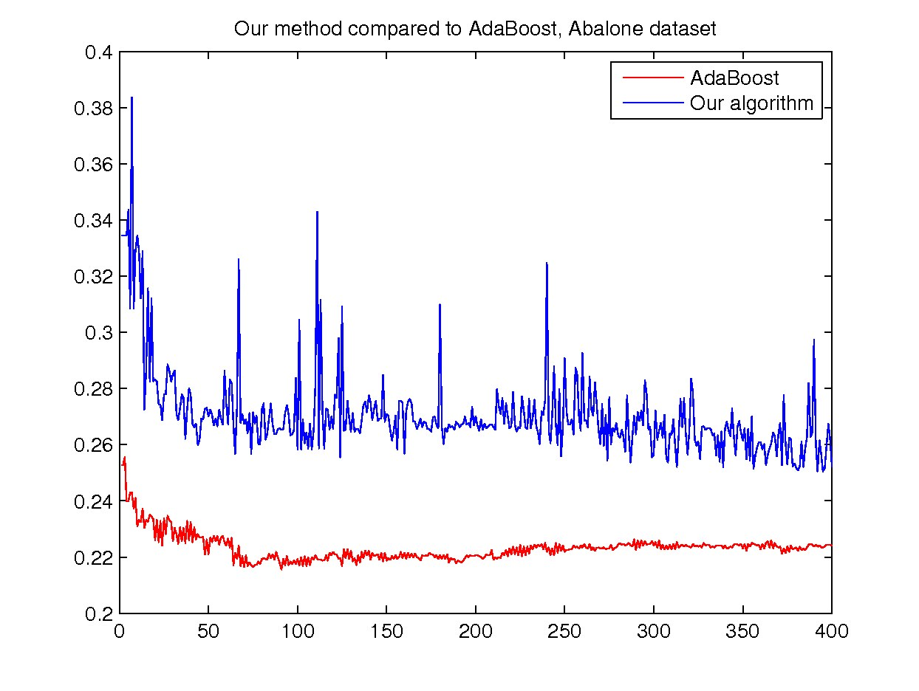
Our Algorithm Comparison to AdaBoost
Abalone Dataset Note that Adaboost, while converging faster in terms of iterations, also requires a much larger computational effort on each iteration

Slide 31
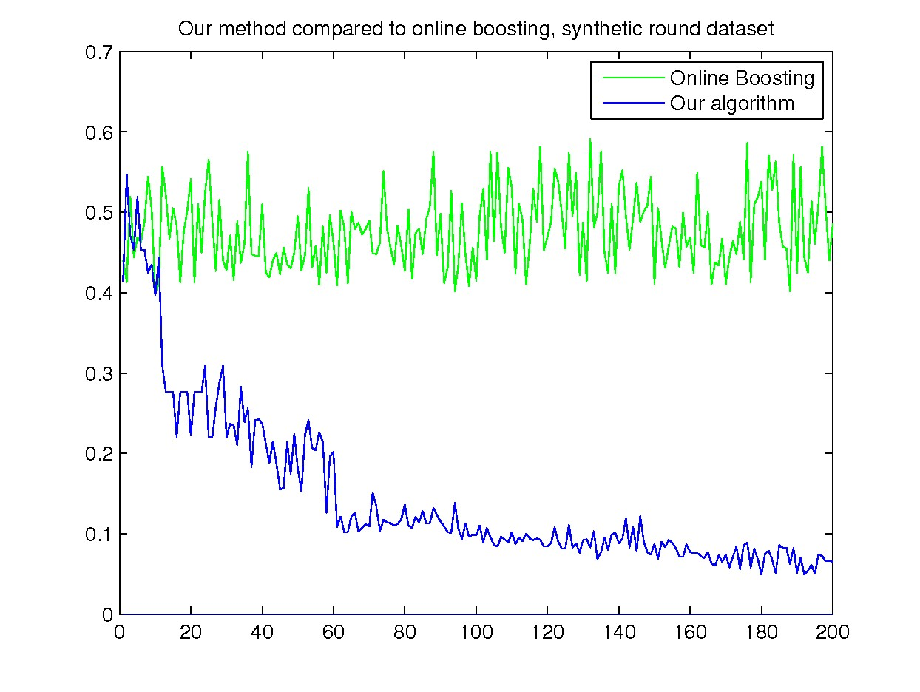
Our Algorithm Comparison to online boosting
Simple nonlinear dataset. Online boosting does not converge!

Slide 32
Summary of the first part
A new online training algorithm combining boosting and support vector machines has been introduced
Several experiments of different datasets has shown it to outperform kernel-based SVM training algorithms, such as NORMA and Pegasos, while having reduced computational and storage requirements
The lightweight quality allows our algorithm to be easily implemented on the variety of the devices, including mobile devices like iPhone
Since most of the calculations in the update process can be made parallel, availability of programmable GPUs may allow to use it for real-time image processing tasks, like partial segmentation and object tracking
An article describing this algorithm has been submitted to ISRN Signal Processing journal and is currently under review.

Slide 33
GPGPU computation and its relevance to the proposed method
Recently, parallel computing afforded by powerful Graphics Processors is often used to perform computational tasks not related to computer graphics
Several specific programming languages has appeared to leverage the GPGPU potential, like CUDA and Cg.
The proposed algorithm can, with minimal modifications, be used in parallel setting.
This results for significant speed up in computation on GPU-like devices, making such tasks as real-time object tracking possible on the devices with low CPU processing power, such as mobile phones

Slide 34
iPhone programmable graphics pipeline
iOS versions, starting from iOS 4, support programmable graphics pipeline on newer iPhones
Fragment shaders are small programs that perform parallel computations on each pixel of an image
This allows to use the device GPU to perform computational tasks
However, there are many limitations that are specific to mobile devices with limited resources
Also, shaders do not give the flexibility comparable to languages like CUDA
We show how our method can be utilized on such devices to achieve high speed image processing tasks.

Slide 35
iPhone programmable graphics pipeline PowerVR SGX architecture

Slide 36
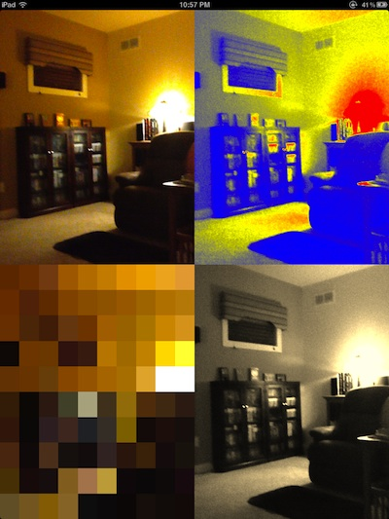
GPUImage programming library
A very simple and efficient API that allows to represent calculations as a series of connected filters

Slide 37
Algorithm implementation Tracking as a classification problem
Tracking of an object in image can be formulated as a binary classification problem that determined whether a given rectangle contains the object or not
However, the object changes from frame to frame, so static classifier may quickly lose track [Grabner, 2006]
So, the online updates are necessary
The method they propose, however, is more suited for sequential processing

Slide 38
Algorithm implementation Boosting simple features
The idea originally proposed in [Viola 2001] was to take extremely simple image features and train them to achieve rapid face detection
They used so-called Haar-like features, that were simply a difference between two rectangular regions on an image
Such boosted simple features were successfully used for face detection and object tracking
They can be calculated fast by using integral images
However, such features are not very well suited for parallel processing

Slide 39
Algorithm implementation Choosing right features for parallel processing
Most of the features used for object detection and tracking, such as haar-like features and histograms, use a large amount of image pixels and have various possible scales and orientations
While on a desktop, they can be calculated rapidly by using integral images
It is not possible on the current version of the iPhone GPU
New features are necessary for GPU implementation.

Slide 40
Algorithm implementation Minimalized features
For each feature, two random offsets are chosen
For each pixel on the image, luminance of the offset pixels is compared and saved as a feature
In addition, color information of all three pixels is used.
These features are very simple, and carry very little information, so boosting is necessary.

Slide 41
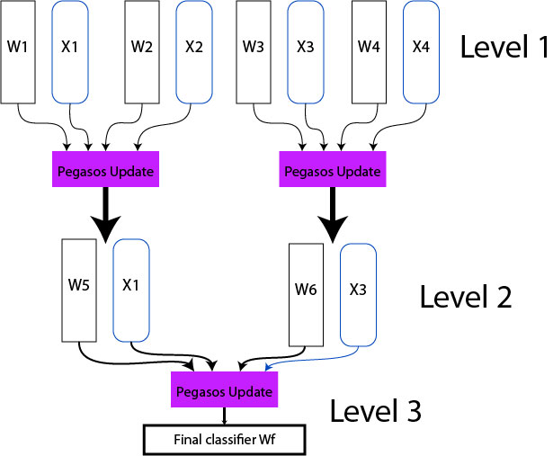
Pegasos modified for parallel processing
A classical hierarchical scheme
As accurate as a linear variant
Unfortunately, too many rendering calls reduce efficiency, so it cannot be used well on the current mobile systems

Slide 42
Algorithm implementation Combined online and batch learning
Due to simultaneous addition of a large amount of labels and raining sample, the algorithm takes the following form:

Slide 43
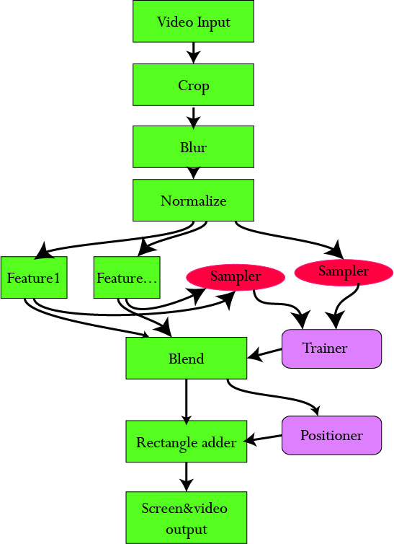
Algorithm implementation Resulting Graphics pipeline
The positioning and training are running in parallel on the CPU while the next frame is being processed
Not enough precision to run it on GPU yet
Training with several thousands samples only takes ~10ms, anyway.

Slide 44
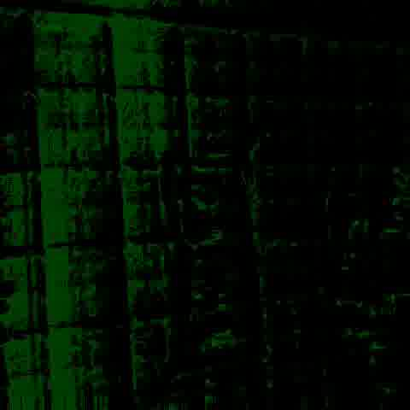

Implementation results
Confidence map is trained to be positive on the object position and negative in the neighborhood (ROI)
It converges well in most cases

Slide 45
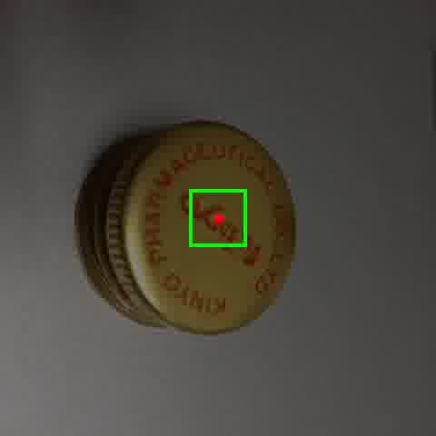
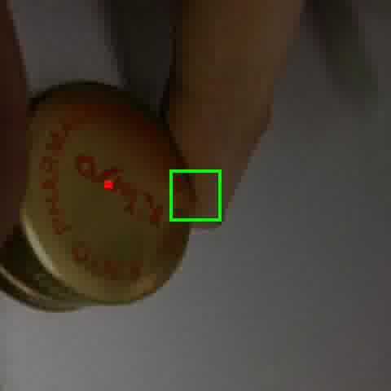
Implementation results
Some object can be tracked reasonably well
If the confidence map has converged, which can be prevented by jitter

Slide 46
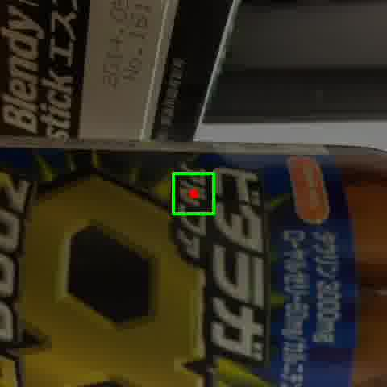
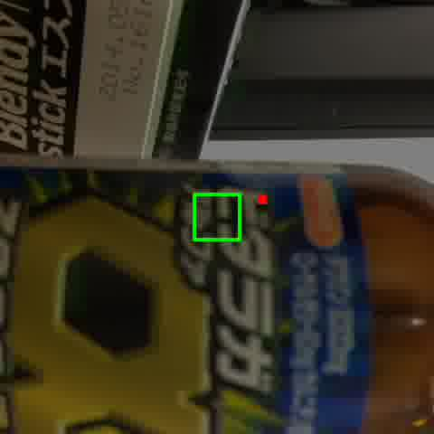
Implementation results
However, due to the imperfect implementation of the tracking procedure itself, fast movements and high similarity regions will result in a loss of track
The training algorithm is fine, but sometimes too fast

Slide 47
Relation of proposed implementation to existing work
Our sample features:
Binary comparison
Color information
In the article “Fast keypoint recognition using random ferns” (2010), Mustafa Ozuysal et.al proposed fetures based on binary comparison only (for greyscale images)

Slide 48
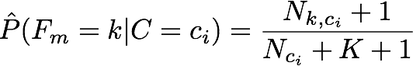
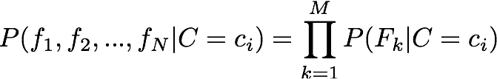
Relation of proposed implementation to existing work Introducing FERNs for image processing
FERNs
Mainly multiclass
Originally used to identify image patches
Use simple binary features: comparison of pixel luminosity values at offsets
They combine several features into one value, creating a FERN, by calculating their joint probability for each class
The FERNs are then combined using naïve Bayesian model

Slide 49
Adapting Ferns for use with our method
Normal FERN method uses naïve Bayesian to combine individual FERNs
When log-likelihood is used, naïve Bayesian is the same as unweighted sum
Individual FERNs are not truly independent, especially very short or very long ones, introducing inaccuracy
The accuracy can be improved by using SVM to calculate weights
Individual FERNs are used as first-level SVM outputs, binary or log-probability.

Slide 50
Relation of proposed implementation to existing work
SVM are best used for two-class problems, though they can be adapted to multiclass and single-class
FERNs are multiclass
FERNs can be adapted for use as texture classifiers, reducing the number of classes.
For this experiment, SVM are pre-trained

Slide 51
Texture recognition with Ferns Implementation of simple texture recognition on iPhone GPU
Adding colors
The colors are combined according to above formula
Since a large number of FERNs cannot be run on shaders (the practical limit for iPhone4S is about 4-8 FERNs per shader, depending on the number of features per FERN), they are either aggregated, or their number reduced

Slide 52
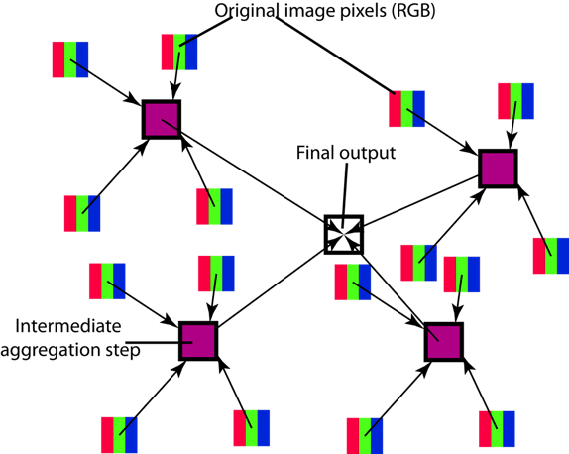
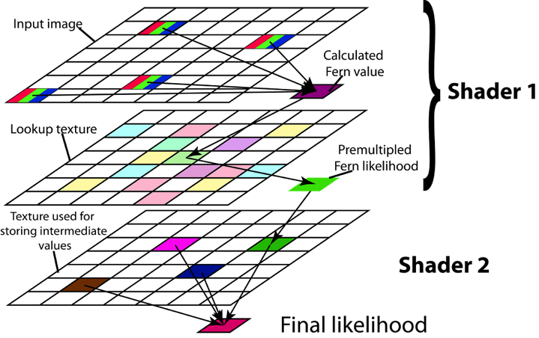
Texture recognition with Ferns Implementation of simple texture recognition on iPhone GPU
Since a large number of FERNs cannot be run on shaders (the practical limit for iPhone4S is about 4-8 FERNs per shader, depending on the number of features per FERN), they are either aggregated, or their number reduced

Slide 53
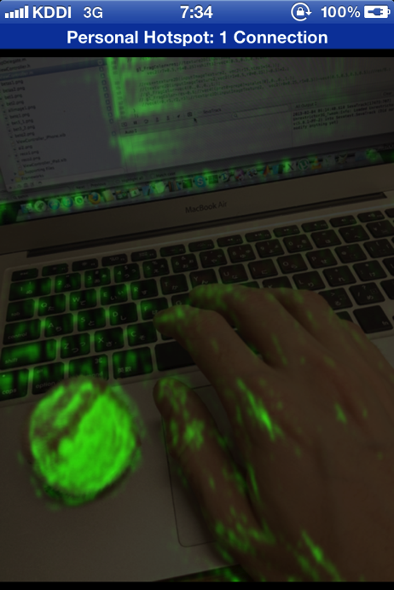
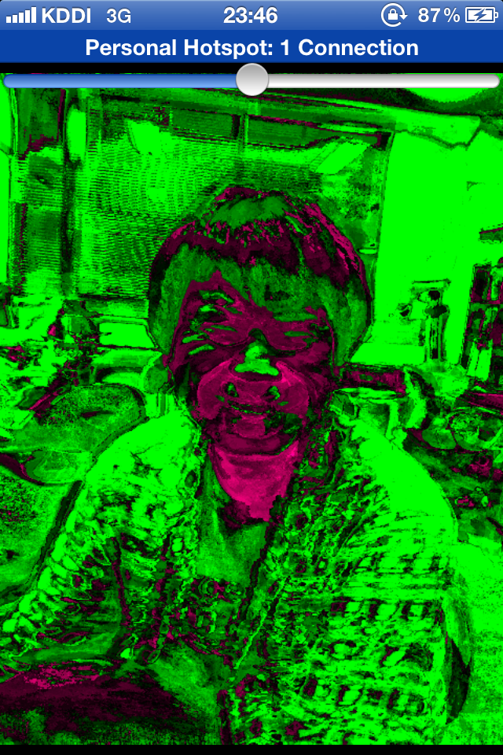
Texture recognition with Ferns Results

Slide 54
Implementation results: Conclusion.
The tracking application works reasonably well even on the unstable features presented.
The application, despite a debug-level implementation runs at about 10~15 fps, the bottleneck being inefficient feature samplers
It works well as a proof-of-concept for the proposed learning method.
An additional method was developed involving advanced usage of the simple features described in the FERNs article
The advanced method and its implementation results have been published

Slide 55

Spectrum of related classification methods
Joint Bayesian Inference
Perceptrons
Our Method
Our method + FERNs
FERNs
Kernel-based SVM with good kernel
Linear SVM
Naïve Bayesian

Slide 56
Method comparison
Method | Pros | Cons
AdaBoost | Relatively fast training Provides near-optimal solution | Offline Sensible to noise
Online Boosting | Online training | Fixed number of features
SGD-based SVM | Simple to implement Works well on large amounts of data | Uncontrolled kernel expansion. The need to fine-tune kernels.
FERNS | Use simple, fast to calculate features. Simple implementation | Requires a large number of features
Our method | Controlled kernel Good convergence speed regardless of parameters | Increased complexity Increasing memory rquirements
Our method+FERNs | Same Pros as FERNs Gives better accuracy | Not as effective in case of multiple classes

Slide 57
Conclusion
A new classification method has been introduced
Several experiments has shown that the proposed method is often superior to the existing methods in both convergence speed and necessary computational intensity
An experimental implementation of the method on the mobile device was proposed.
For this implementation, the discrimination power of limited 3-pixel features was investigated
The training algorithm was found to perform well for the task, however the proposed features are too unstable for precise use.
Furthermore, the similarity between proposed simple features and FERNs was noted

Slide 58
Conclusion
Based on that similarity, the improved method was proposed, combining Ferns and our training algorithm to increase accuracy of estimated likelihood
The method was shown to provide improved accuracy for two-class FERNs
The simplified combined method was also implemented on iPhone GPU, showing increased accuracy compared to original FERNs
This applications have proven the applicability of our method to image processing tasks.

Slide 59
References
Shai Shalev-Shwartz, Yoram Singer, and Nathan Sre- bro. Pegasos: Primal estimated sub-gradient solver for svm. (2007)
Jyrki Kivinen, Alexander J. Smola, and Robert C. Williamson. Online learning with kernels. (2004)
Vladimir N. Vapnik. The Nature of Statistical Learning Theory. (1995)
Blackard. Comparative accuracies of artificial neural networks and discriminant analysis in predicting forest cover types from cartographic variables. (1999 )
M. Grabner H. Grabner and H. Bischof. Real-time tracking via on-line boosting. (2006).
by P Viola, M Jones
P Viola, M Jones ,Rapid object detection using a boosted cascade of simple features (2001)

Slide 60
Publications
Vsevolod Yugov and Itsuo Kumazawa, “Online Boosting Algorithm Based on Two-Phase SVM Training,” ISRN Signal Processing, vol. 2012,
Vsevolod Yugov and Itsuo Kumazawa, Combination of SVM and FERN for GPU-assisted texture recognition on mobile devices

